Slide 1
Data Protection At EUROJUST and exchange of personal data with third states
Diana Alonso Blas, LL.M.
DPO/ Head of DP service at Eurojust

Slide 2
Eurojust
What Is Eurojust?
EU Judicial Cooperation Unit (2002)
What Is Eurojust Doing?
stimulates and improves coordination of investigations and prosecutions;
improves the cooperation by facilitating the execution of MLA requests, EAW and extradition requests
Aim?
to support in any way possible the competent authorities of the Member States to render their investigations and prosecutions more effective when dealing with cross-border crime

Slide 3
Casework 2014 – 2018 (31 August)
Total 31 August 2018
1809

Slide 4
Data Protection is crucial for Eurojust
Eurojust needs to receive, store and further process personal data to deal with the cases referred by national authorities
Eurojust deals with personal data on persons subject of a criminal investigation or prosecution, witnesses and victims + persons having been convicted
Data Protection is a one factor that can strongly influence the successful performance of the organisation and the trust that other organisations puts on us

Slide 5
Principles of general application
Right to privacy and data protection, regardless of nationality or place of residence. Right to privacy is a fundamental human right since 1950 (ECHR + caselaw)
Fair and lawful processing, proportionality and necessity
Purpose limitation
Data should be accurate and up to date. Not kept for longer than necessary, need to keep an eye on existing legal requirements!
Need to know principle
Confidentiality of processing (obligation of professional secrecy)
Security: technical and organisational measures, appropriate to risk

Slide 6
DP regime of Eurojust: robust, effective and tailor-made
Eurojust Decision contains detailed provisions on data protection (Articles 14-25)
Other European instruments:
ECHR (Article 8)
CoE Convention 108
Charter EU (Articles 7-8)
Article 16 Treaty of Lisbon
Eurojust
Art.14: Processing of personal data
Art.15: Restrictions on the processing of personal data
Art.16: CMS, index and temporary work files
Art. 16a: Functioning of temporary work files and index
Article 16b: Access to the CMS at national level
Art.17: Data Protection Officer
Art.18: Authorised access to personal data
Art.19: Right of access to personal data
Art.20: Correction and deletion of personal data
Art.21: Time limits for the storage of personal data
Art.22: Data Security
Art.23: Joint Supervisory Body
Art.24:Liability for unauthorised or incorrect processing of data
Art.25: Confidentiality
Revised Eurojust Decision of 16 December 2008 reinforces the DP system, defining more precisely provisions and introducing some principles of DP RoP in the text
Rules of Procedure on the processing and protection of personal data (adopted unanimously by College of Eurojust in October 2004 and by Council in February 2005)
Title I: Definitions
Title II: Scope of application and structure
Title III: Principles of general application to Eurojust
Title IV: Rules for case-related processing operations
Title V: Rules for non-case-related processing operations
Additional Rules of the Rules of
Procedure to non-case-related operations
(Decision of College of June 2006)

Slide 7
Main features of the Eurojust DP regime
The Eurojust DP regime complies with all the same general principles of other EU instruments but:
It is adapted to the specific nature of the activities of EJ (in line with declaration 21 of TFEU)
It is very detailed and precise, offering therefore great legal certainty to data subjects
- EJ rules contain additional safeguards for victims and witnesses with strict conditions and time limits for processing of such data
- It has defined rules on possible access to the information
- A system of data retention with regular review of compliance
- Obligations to keep the data updated, relevant and not excessive
All those rules have been technically implemented in CMS - a good example of “privacy by design”
Legal certainty is key in this field. ➔ Specific rules offer more protection!

Slide 8
Main features of Eurojust DP regime II
Rights of the individuals – specificity of the activities (ongoing investigations or prosecutions)
Every request is dealt on a case by case basis and takes into account all interests at stake and makes efforts to provide information whenever possible
In a recent Court case, the General Court has praised the way EJ was dealing with data subject requests (judgment of 25 November 2010 in case T-277/10AJ K v Eurojust):
The General Court of the European Union evaluated very positively the fact that Eurojust had provided the individual information as to the fact that no personal data on him had been processed. The Court found that Eurojust not only duly met the requirements of Article 19(7) of the Eurojust Decision but even exceeded them, since it provided a detailed answer to the applicant’s allegations revealing that no personal data concerning him was processed by Eurojust.
This is also an example of the fact that data subjects are not deprived of their rights to have judicial review of the decisions taken by EJ

Slide 9
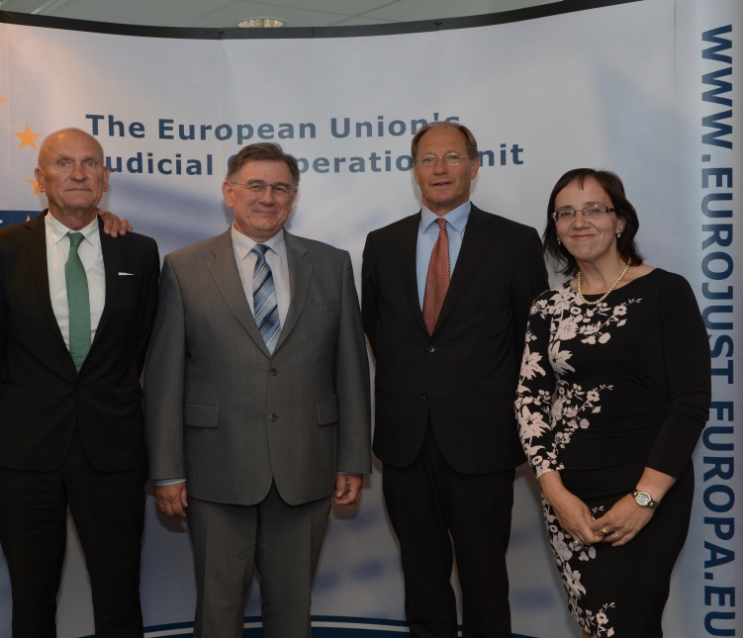
Internal and external supervision
Internal control: DPO (Art. 17 EJ Decision).
Tasks:
- Ensuring compliance and lawfulness in independent manner
- Access to all data and all premises
- Annual survey on compliance
- Procedure in case of non-compliance
- Postholders can address enquiries/requests/claims/complaints. No one shall suffer prejudice!
DP service is there to advise controllers regarding processing of personal data issues and basically to “sell DP” within the organisation
External control: Joint Supervisory Body (Art. 23) monitors the correct application of the rules on DP and carries out frequent inspections

Slide 10
Future DP regime: harmonised but robust, effective and tailor-made
Revised Regulation 45/2001
Chapter VIII a (lex generalis)
Eurojust Regulation (lex specialis)
Exchanges of info between the MS and NMs
CMS, index and temporary work files
Processing of personal data by Eurojust
Processing of operational personal data
Processing under the authority of EJ or processor
Time limits for storage of op. personal data
Security of operational personal data
Right of access by the data subject
Limitations to the right of access
Right to rectification or erasure of operational personal data and restriction of processing
Authorised access to operational personal data
Records of categories of processing activities
Designation of the DPO
Position of the DPO
Tasks of the DPO
Communication of a personal data breach to the authorities concerned
Supervision by EDPS - Professional secrecy by EDPS
Cooperation between EDPS and national DPAs
Right to lodge a complaint with the EDPS with respect to operational personal data
- Right to judicial review against the EDPS
Responsibility in DP matters
Liability for unauthorised or incorrect processing
Common provisions
Liaison magistrates posted to third countries
Section IV: transfers of personal data
Annex II on categories of data subjects
Eurojust: operational data regime
Scope: without prejudice to specific DP rules
Principles
Lawfulness
Distinction between different categories of data subjects
Distinction between operational data and verification of quality of operational data
Specific processing conditions
Processing of specific categories of operational personal data
Automated individual decision making, including profiling
Communication and modalities for exercising the rights Information to be made available or given to the data subject
Right of access by the data subject
Limitations to the right of access
Right of rectification or erasure of operational personal data and restriction of processing
Right of access in criminal investigations and proceedings
Exercise of rights by the data subject and verification by EDPS
Data protection by design and by default
Joint controllers
Processor
Logging
Data protection impact assessment
Prior consultation of the EDPS
Notification of personal data breach to the EDPS
Communication of a personal data breach to the data subject
Security of processing of operational personal data
Transfer of personal data to third countries/int. organisations
Supervision by the EDPS
Rules of Procedure to be reviewed
+
internal procedures to be reviewed

Slide 11
Case Management System (CMS): functionalities
Support to management and coordination of prosecutions which Eurojust is assisting:
- Eurojust case cycle (registration, meetings, message exchange)
- Enable cross-references between entities (persons, places, etc) and automatic detection of potential links between cases
B) Facilitation of access to information (Data Management):
- Interaction between NMs (TWFs and Index)
- Statistics
C) Enforcement of Eurojust Data Protection Rules

Slide 12
Data Protection features in CMS: privacy by design/default
Data subjects rights’ management, ensuring appropriate procedure and consultation
Procedure for the exceptional registration of sensitive data, ensuring appropriate procedure
Restrictions concerning personal data to be included in the index (preventive approach)
Accuracy of data: ensuring mutual information when information is modified
Choice on the position of personal data record by record (TWF - local part or shared part, index)
Log file review possibility by DPO/JSB
Monitoring of respect of data time limits
Automatic notifications to the DPO:
-Processing of sensitive data
-Incoming data subjects’ rights requests
-Creation of new TWFs
-Reviews on personal data time limits

Slide 13
Cases concerning non-EU states
At the request of a MS competent authority, Eurojust may assist investigations and prosecutions concerning only that MS and a non-Member State, where:
a cooperation agreement with that third State has been concluded, or
in the absence of such agreement, there is an essential interest in providing assistance in a specific case.

Slide 14
Eurojust Decision and Cooperation Agreements
Article 26: relations with EU institutions, bodies and agencies: more flexible regime
Article 26a: relations with non-MS and int. organisations: strict requirements/control of implementation
Scope of agreement: cooperation in the fields of activity and competences of Eurojust
Exchange of information, including personal data, secondment of liaison magistrates to Eurojust
Eurojust’s Contact Points (42) - tool for improving cooperation but does not provide for the possibility to exchange operational information, including personal data

Slide 15
Exchange of personal data with third States/organisations
Before entering into negotiations (Art. 26a of Eurojust Decision):
- plans for entering into negotiations approved by the College (no approval from the Council is required)
- information to the Council of any plans for entering into negotiations
- the Council may draw any conclusions it deems appropriate

Slide 16
DP requirements to set up agreements with third States/parties
Use of model agreement
Article 27: exchange of info with partners
Possibility to sign agreements including provisions on DP, approved by Council after consultation of JSB
EJ Decision and RoP refer to 3 conditions:
1. the ratification of CoE convention 108
2. the ratification subsequent amendments to this convention (Additional protocol on transborder data flows and existence of an independent data protection authority)
3. the principle of “adequate protection” in the third State
→Important decision of Council of Ministers of Council of Europe of 2 July 2008 (at Deputies level) :
took note of the recommendation of the Consultative Committee of the Convention that non-member states with data protection legislation in accordance with the Convention for the Protection of Individuals with regard to Automatic Processing of Personal Data (ETS No. 108) should be allowed to accede to this convention;
agreed to examine any accession request in the light of this recommendation

Slide 17
State of play third States/parties agreements
Cooperation agreements
- Europol
- Norway: liaison magistrate
- Iceland
- US: liaison magistrate
- OLAF
- former Yugoslav Republic of Macedonia
- Switzerland: liaison magistrate
- Liechtenstein
- Moldova
- Montenegro: liaison magistrate
- Ukraine: liaison magistrate
- Albania (signed, not into force yet)
MoUs
- European Commission
- IBERred
- UNODC
- EMCDDA (Drugs & Addiction)
- EUIPO (Intellectual Property)
- CEPOL
- European Judicial Network
- Frontex
- EUNAVFOR MED
- Interpol
- FRA
- ICC

Slide 18
Adequate protection concept
Content Principles
1) the purpose limitation principle
2) the data quality and proportionality principle
3) the transparency principle
4) the security principle
5) the rights of access, rectification and opposition
6) restrictions on onward transfers
7) protection of sensitive data

Slide 19
Adequate protection concept II
Procedural/ Enforcement Mechanisms
1) deliver good level of compliance with the rules
2) provide support and help to individual data subjects in the exercise of their rights
3) to provide appropriate redress to the injured party where rules are not complied with
Schrems case: The word ‘adequate’ signifies that a third country cannot be required to ensure a level of protection identical to that guaranteed in the EU legal order. However, the term ‘adequate level of protection’ must be understood as requiring the third country in fact to ensure, by reason of its domestic law or its international commitments, a level of protection of fundamental rights and freedoms that is essentially equivalent to that guaranteed within the EU by virtue of Directive 95/46 read in the light of the Charter.

Slide 20
Independence of DPA
Difficult concept: see text of explanatory memorandum of Additional Protocol to CoE Convention 108
Court of Justice case towards Germany + Austria+ Hungary
GDPR (Chapter VI) and (Police) Directive (EU) 2016/680 (Chapter VI)

Slide 21
Future legal framework
Eurojust Regulation (± end of 2019) - no longer able to negotiate coop. agreements
Eurojust will be able to conclude working arrangements (to set out the modalities to implement agreements or adequacy decisions). Int. agreements will be negotiated by the COM
Transfer of personal data to a third State will be on the basis of one of the following:
(a) COM’s adequacy decision/appropriate safeguards are adduced or exist/derogations for specific situations;
(b) on the basis of a coop. agreement concluded before Eurojust Regulation;
(c) on the basis of an international agreement concluded between the EU and the third State
Alignment with Directive (EU) 2016/680 and revised Regulation (EU) 45/2001
Not affecting international agreements concluded before Eurojust Regulation

Slide 22
Diana Alonso Blas
Data Protection Officer/ Head of DP Service
dalonsoblas@eurojust.europa.eu

